Slide 1

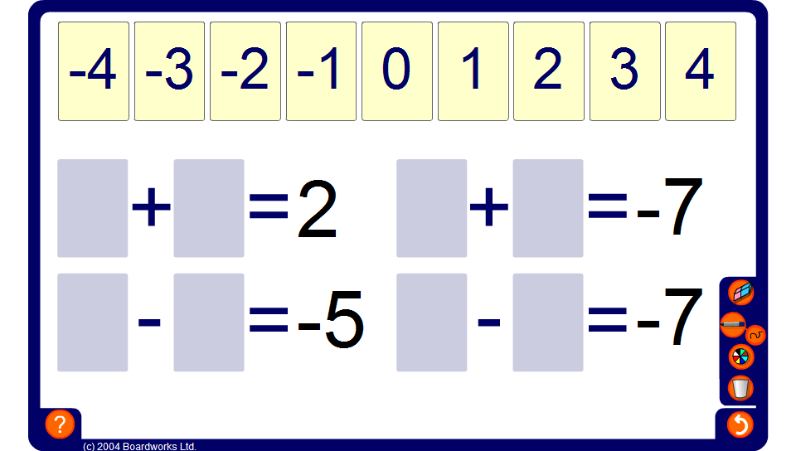


Integer cards - addition and subtraction
Notes:
Ask volunteers to come to the board to show a solution for each calculation. Tell them that each example must include at least one negative integer card.
Discuss all possible solutions for each calculation and ask pupils to tell you any patterns or relationships that they notice.

